Slide 1

ZOMATO DATA ANALYTICS
Analytics done by :
Ansh Jain
jainanshhhm@gmail.com

Slide 2

Problem Statement
Find suitable countries and cities for new restaurant expansion.
Review restaurant quality using existing customer ratings.
Study current food spending behavior in these regions.
Identify key competitors in the market.
Highlight cuisines with strong growth potential.
Analyze trends in online delivery and table bookings.
Identify the top-preferred cuisines.

Slide 3
Data Overview
  Raw Dataset: 20 attributes containing restaurant details.
  Enhanced Dataset: Expanded to 24 attributes after preprocessing.
  Restaurant Data Description: Includes restaurant name, location, cuisines, cost, and ratings.
  Country Dataset: 6 attributes providing country-related information (country code, name, currency, symbol, etc.).
Data Cleaning and Preprocessing:
Standardized city names and corrected date formats.
  Treated missing and inconsistent data entries.
  Added country-level details using lookup techniques.
  Removed unnecessary special characters from text fields.
  Revised average cost and cuisine information based on defined rules.
  Used conditional formatting to mark regions with low restaurant presence and high expansion opportunity.
  .

Slide 4
Year Wise Growth of Restaurant Listing
The restaurant market remained consistently stable, with counts always above 1000 across all years.
After a decline from 2011 to 2015, the market started showing clear recovery and growth from 2016 onward.
A major upward jump in 2017 and 2018 highlights strong expansion and increasing business opportunities.

Slide 5
Restaurant Presence By Country
India holds the major market share with maximum restaurant presence.
Other countries show low market availability, indicating growth potential.
The United States is second, but far below India’s volume.
India remains the primary focus market for business expansion.

Slide 6
Average Restaurant Ratings by Country
Most countries have ratings above 4.0, indicating high customer satisfaction globally.
Philippines, New Zealand & Turkey show the highest ratings (~4.3–4.5) → strong service quality.
India has the lowest rating (2.8), showing a quality improvement opportunity.
Overall, ratings remain consistently positive, reflecting good dining experiences worldwide.

Slide 7
Average Cost Of Two(INR)
Singapore is the most expensive (₹13,924), far above others.
India Sri Lanka and Turkey are the cheapest dining options.
Qatar ,Canada and UAE fall in the mid-to-high cost range.
Costs reflect big lifestyle and purchasing power gaps across countries.

Slide 8
Analysis – Opening New Restaurants
Identify countries with lower competition levels.
Suggest suitable cities and states for new restaurant openings.
Analyze restaurant ratings in the targeted countries.
Study food expenditure trends in the selected regions.
Examine major competitors in the market.
Evaluate cuisine demand and growth opportunities.
Review trends in online bookings and table deliveries.
Analyze the correlation between cuisine popularity and customer ratings.

Slide 9
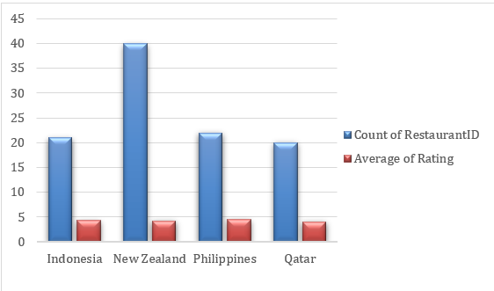
Country Analysis
New Restaurant Location Strategy
The selection of expansion countries is based on two main factors:
Lower Market Competition – Allows Zomato to enter and grow easily in underserved regions.
Moderate to Good Ratings – Indicates that customers are generally satisfied with existing restaurants, showing a healthy demand and scope for better options.
Suggested Countries for Expansion:
Indonesia, Philippines, New Zealand, and Qatar.

Slide 10
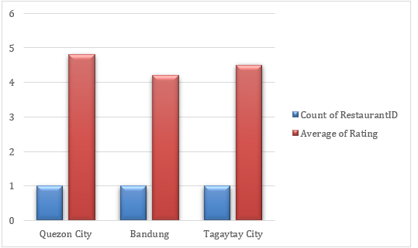
City Analysis
Cities:
      Bandung
      Quezon City
      Tagaytay City
Why These Cities :
⭐ High Ratings: Avg. restaurant ratings > 4.0 → Customers are satisfied
🍽️ Food-Loving Audience: Mature market, appreciates quality dining
🚀 Growth Potential: Premium & unique dining experiences likely to attract customers

Slide 11
Cuisine Analysis
Cuisine Recommendations:
These are the highest rated cuisines across all countries.
Cuisines with mostly Restaurant Serve
  North Indian
  North Indian, Chinese
  Chinese
  Fast Food
  North Indian, Mughlai
  Cafe
  Bakery
  North Indian, Mughlai, Chinese
  Bakery, Desserts
  Street Food

Slide 12
Table Booking Analysis
Table Booking:
  More than half customers prefer convenience 55% table booking
  Big opportunity to target the remaining 45–46% by improving service and offers.
  Providing Table booking can maximize reach and revenue.

Slide 13
Online Delivery Analysis
Online Delivery
  More than half customers prefer convenience — 54% Online Delivery
  Big opportunity to target the remaining 45–46% by improving service and offers.
  Providing Online Delivery can maximize reach and revenue.

Slide 14
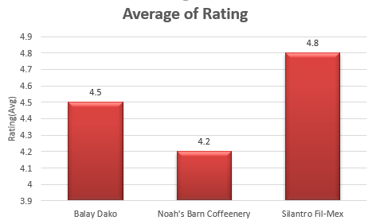
Restaurant Analysis
Balay Dako
Noah's Barn Coffeenery
Silantro Fill-Mex

Slide 15
Methodology
  Performed data analysis, cleaning, preprocessing, and visualization using Microsoft Excel.
  Utilized Excel features including Pivot Tables, Conditional Formatting, Lookup Functions, and Statistical Functions to streamline workflows.
  Executed data cleaning, preprocessing, enrichment, and enhancement to prepare datasets for analysis.
  Conducted correlation analysis and summarized insights using pivot tables.
  Created visualizations with charts and graphs, applying conditional formatting to highlight key trends and strategic insights.

Slide 16
Methodology
Enrichment and Enhancement:
Enhanced datasets by adding country information using lookup functions.
Calculated new metrics and performed correlation analysis.
Data Analysis and Visualization:
Summarized data effectively using pivot tables.
Created visualizations with charts and graphs to identify trends.
Applied conditional formatting to highlight strategic insights.

Slide 17
Strategic Recommendations
Expansion: Open new restaurants in Indonesia, Philippines, New Zealand, Qatar; focus on cities with low-moderate competition (e.g., Bandung, Quezon City, Tagaytay City).
Service: Implement online delivery and table booking for better customer experience.
Cuisine Strategy: Focus on highly-rated cuisines and maintain quality, presentation, and service.
Pricing: Affordable/mid-range in Indonesia & Philippines; premium pricing in New Zealand & Qatar.
Differentiation: Offer unique menu items, superior service, and convenience features.
Monitoring: Continuously track competitor ratings, cuisine trends, and customer feedback using pivot tables and dashboards.

Slide 18
Conclusion
Majority of restaurants are budget-friendly, with premium options being limited.
Average ratings are high (>4) across suggested countries, reflecting strong customer satisfaction.
Countries like Indonesia, Philippines, New Zealand, Qatar show moderate competition and good market potential.
Offering online delivery and table booking positively impacts ratings.
Cuisine choice has weak correlation with price, but quality drives customer satisfaction.

Slide 19
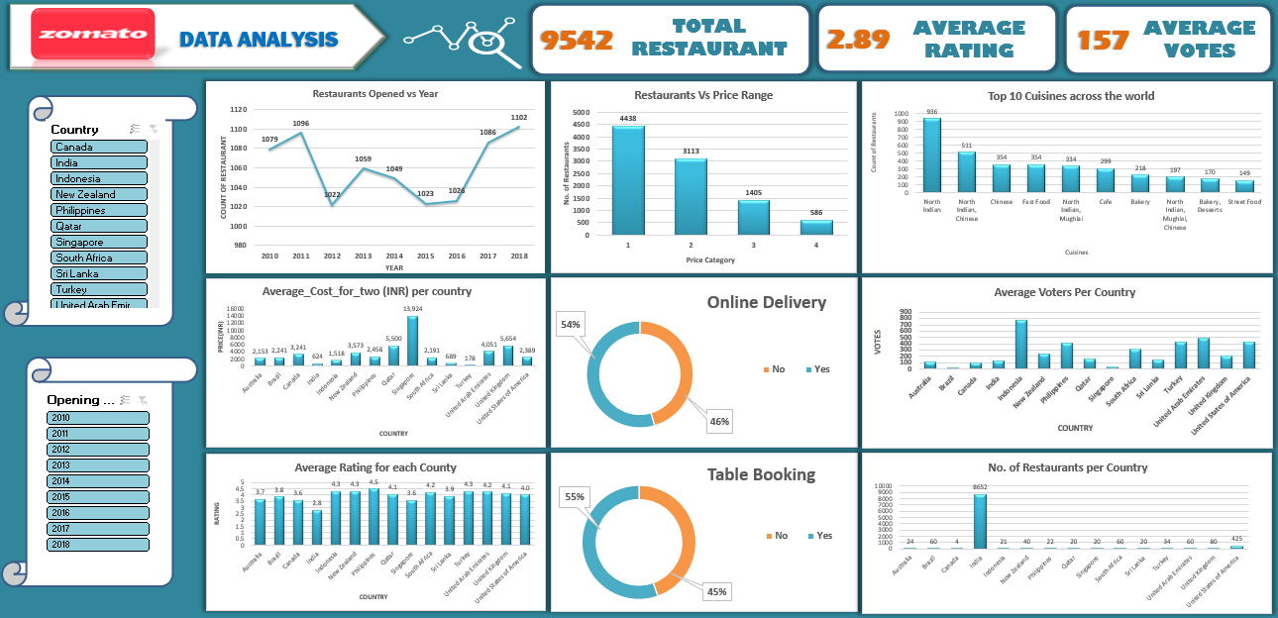
DASHBOARD

Slide 20


